Slide 1
Special Thanks
First of all I would like to thank:
My project supervisor, Dr. Abdulrahman Sayed for their guidance, support, and valuable feedback throughout this project
All instructors and faculty members who contributed to my academic journey
My friends, and family for their encouragement and motivation
This project would not have been possible without your support.
Thank you!

Slide 2
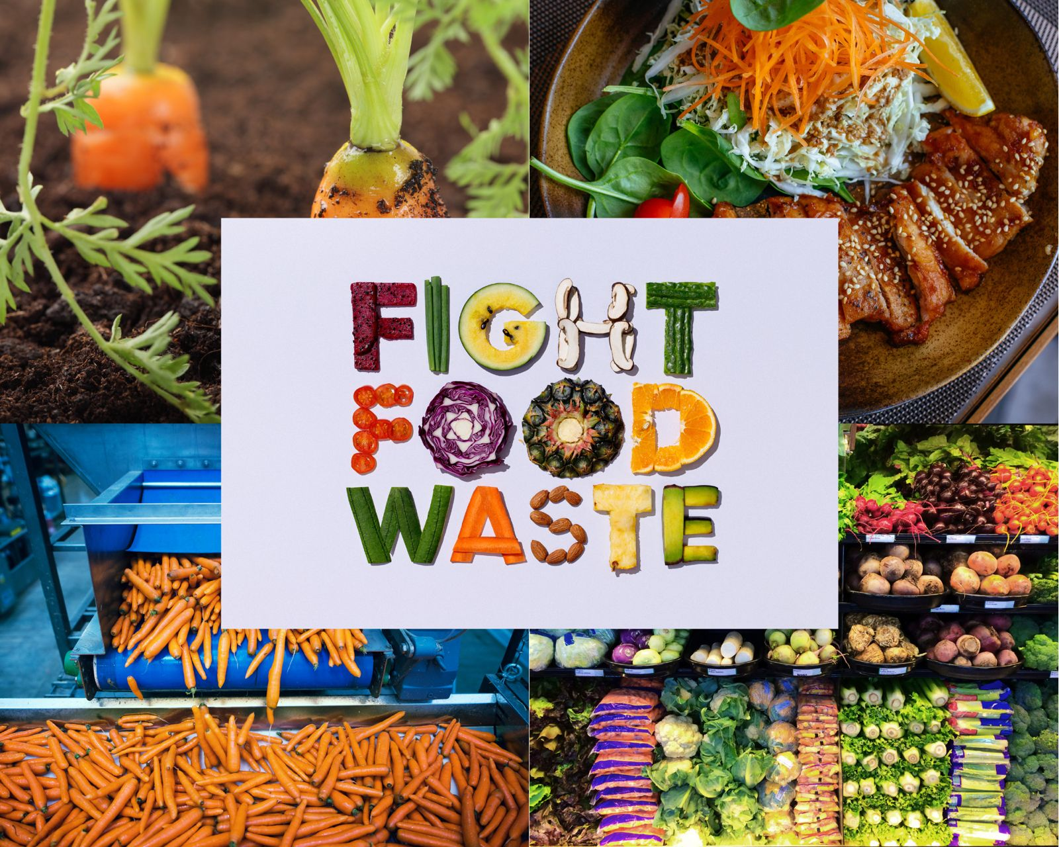
SmartWaste: Minimizing Food Waste with Recipes
SmartWaste is a mobile app designed to reduce food waste by suggesting recipes based on your available ingredients. It combines machine learning and modern backend technology for smarter cooking decisions.

Slide 3

The Problem We're Solving: Wasted Food, Wasted Resources
Common Recipe Apps
SmartWaste Advantage
Impact
Require searching by dish name, ignoring what’s available in the kitchen.
Suggests recipes based on actual ingredients to prevent spoilage.
Helps users reduce wasted food and save resources effectively.

Slide 4

Definition
SmartWaste Architecture Overview
User Interaction
Backend Logic
MI Model
Registration, login, and ingredient input on mobile app.
FastAPI server communicates with the machine learning (ML) model to provide recipe recommendations.
The K-Nearest Neighbors (KNN) algorithm is used to find recipes based on the similarity of input ingredients.

Slide 5
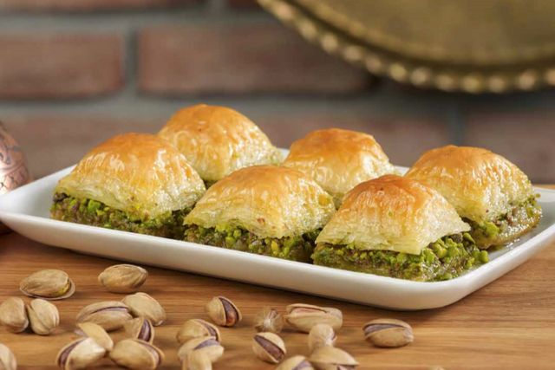
SmartWaste: How It Works
Input
Processing
Output
User enters available ingredients via app interface.
Ingredients are cleaned and normalized for accuracy.
The app returns 5 recommended recipes ranked by similarity score, showing dish names, ingredients, and relevance percentage.

Slide 6



Data Cleaning and Preparation
Standardization
We did normalize the ingredients manually and by using OpenAI to expand and normalize ingredient names.
2
Source Data
1
Lebanese recipe dataset.
Cleaning Steps
3
Removed quantities, mapped synonyms for consistency, Simplifying labels, Removing non-essential ingredients

Slide 7

Model Implementation: KNN Machine Learning
1
Vectorization
2
Similarity Metric
3
Model Output
MultiLabelBinarizer converts ingredients into vectors.
Cosine similarity identifies nearest recipes and it was chosen for:
Ranks top recipe matches based on input ingredients.
Focuses on ingredient pattern, not quantity
More accurate than Euclidean for binary vectors
Easy to interpret (0–100% similarity score)

Slide 8

Backend with FastAPI
Key Features
JSON Web Tokens JWT-secured user registration and login
Benefits
Passwords are securely hashed before being stored (using bcrypt)
FastAPI offers speed and reliability for smooth app
experience.
Ingredient input sent to the backend via a POST request
and the model KNN Finds the 5 recipes with the highest similarity scores.
Supabase (PostgreSQL) used to store user and recipe data
App → FastAPI → Ingredient Vector → KNN → Recipe Matches → App

Slide 9
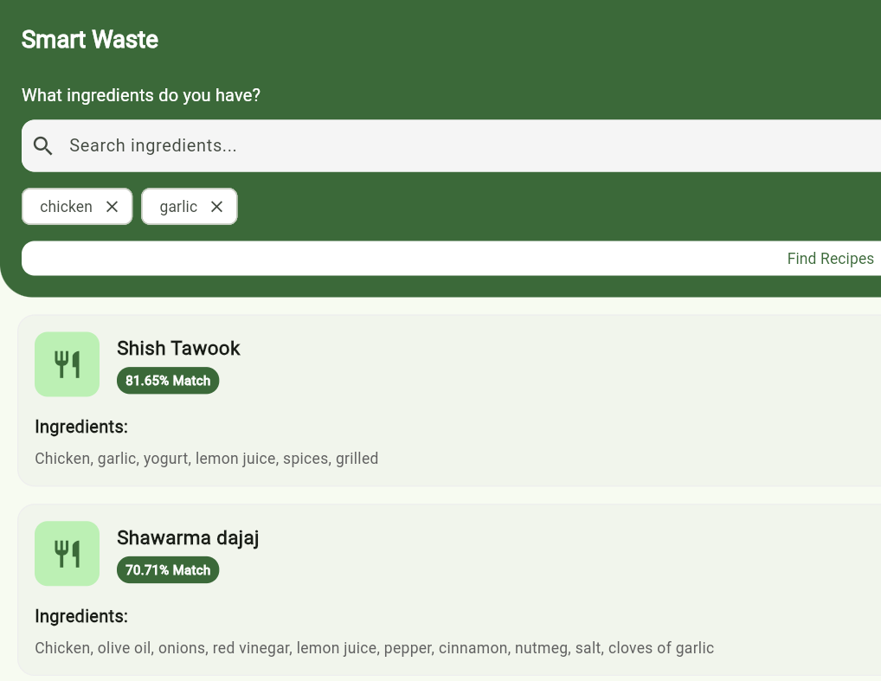
Flutter Mobile App Interface
Cross-Platform
User Actions
Developed in Flutter for both iOS and Android.
Register and log in securely
Input ingredients easily
Receive top 5 recipe suggestions
Focus
Simple and responsive UI for better usability.

Slide 10
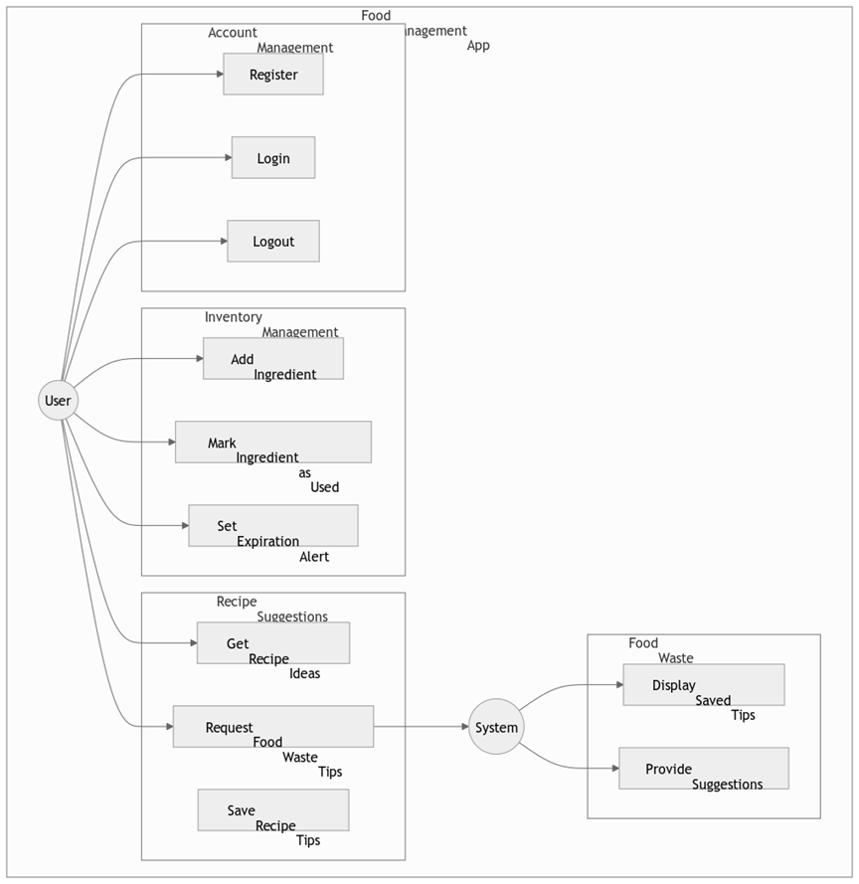










Use Case:
This use case covers the user authentication process. It includes both registration and login. The system ensures credentials are valid before granting access and it outlines a kitchen management system where users log in to track ingredients and receive recipe suggestions. For example, after marking ingredients as used, the system could generate recipe ideas based on remaining stock.

Slide 11
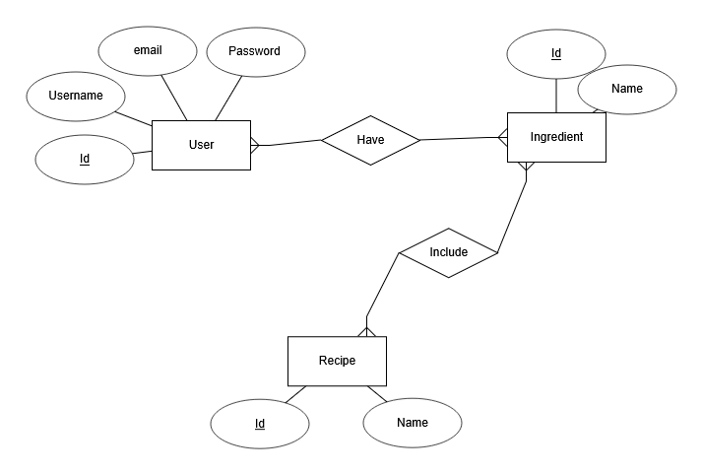
Entity-Relationship Diagram (ERD) Overview
Key Observations:
Entities Identified:
The ERD includes entities such as User, Username, Id, Email, and Password, suggesting a focus on user management or authentication systems.
Relations like Have, Include
Potential Relationships:
The terms Have and Include indicate relationships between entities (e.g., "User has an Email").
Attributes:
Core attributes like Email, Password, Username, and Id are likely tied to the User entity.

Slide 12
Conclusion & Lessons Learned
Technical Insights
Data Processing
Project Management
Effective use of FastAPI, JWT, Flutter, and KNN model.
OpenAI-powered cleaning improved model accuracy.
Coordinating backend and frontend, prioritizing phases was crucial.

Slide 13





Future Improvements for SmartWaste
Personalization
Add dietary preferences like vegan and gluten-free.
Input Methods
Enable voice and camera-based ingredient recognition.
Feedback
Implement user ratings for recipe quality improvements.
Enhancements
Add step-by-step cooking instructions and multi-language support.

